Slide 1

Leveraging the value proposition of the LLVM-based Julia language for DOE computing mission
William F Godoy
Collaborators: Pedro Valero-Lara, Keita Teranishi, Jeffrey S. Vetter, and many more….
Computer Science and Mathematics Division
Advanced Computing Systems Research Section
Intelligent Systems and Facilities and Programming Systems Groups
Prepared for the Smoky Mountains Conference: September 18th, 2024, Knoxville, TN

Slide 2
Immediate “scientific” access to LLVM
julia> function add(x,y)
return x+y
end
julia> function add(x::Float16,y::Float16)
return x+y
end
julia> @code_llvm add(2,3)
; @ REPL[1]:1 within `add`
define i64 @julia_add_132(i64 signext %0, i64 signext %1) #0 {
top:
; @ REPL[1]:2 within `add`
; ┌ @ int.jl:87 within `+`
%2 = add i64 %1, %0
; └
ret i64 %2
}
julia> @code_llvm add16( Float16(2.), Float16(3.))
; @ REPL[3]:1 within `add16`
define half @julia_add16_183(half %0, half %1) #0 {
top:
; @ REPL[3]:2 within `add16`
; ┌ @ float.jl:409 within `+`
%2 = fadd half %0, %1
; └
ret half %2
}

Slide 3
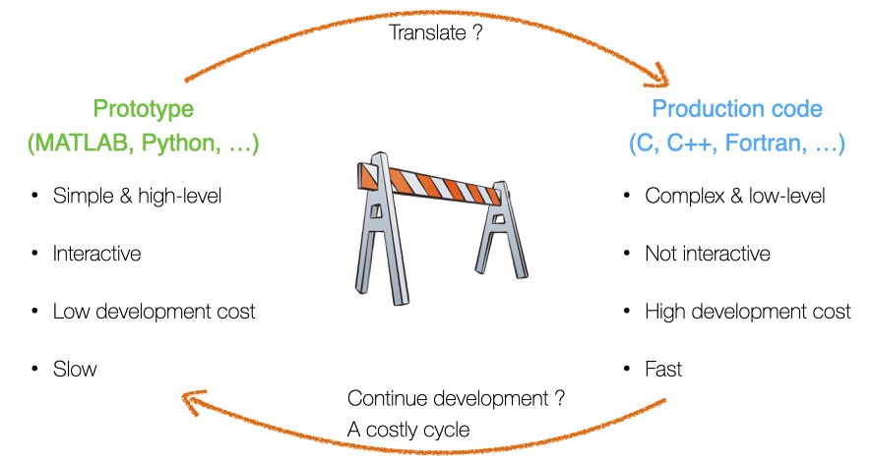
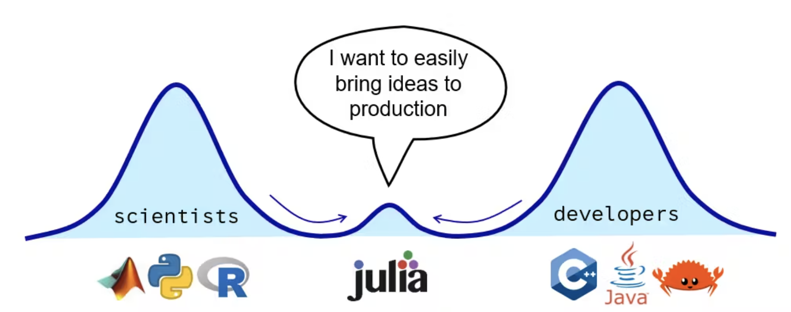
Contents
Julia’s value proposition for science: LLVM + Coordinated Ecosystem
Research efforts in HPC
Community efforts
JACC.jl performance portability in Julia
Summary and Acknowledgements
https://pde-on-gpu.vaw.ethz.ch/lecture7
https://scientificcoder.com/my-target-audience

Slide 4
Contents
Julia’s value proposition for science: LLVM + Coordinated Ecosystem
Research efforts in HPC
Community efforts
JACC.jl performance portability in Julia
Summary and Acknowledgements
https://pde-on-gpu.vaw.ethz.ch/lecture7
https://scientificcoder.com/my-target-audience

Slide 5



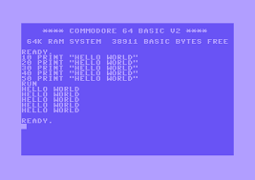


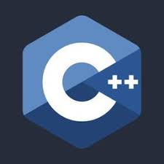























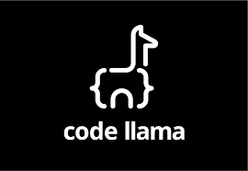



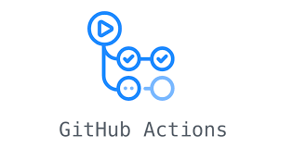

Yet another language?
80-90s
BSc 2002
PhD 2009
NASA postdoc
Intel 2012
ORNL 2016
Today
Things I use today weren't always there

Slide 6






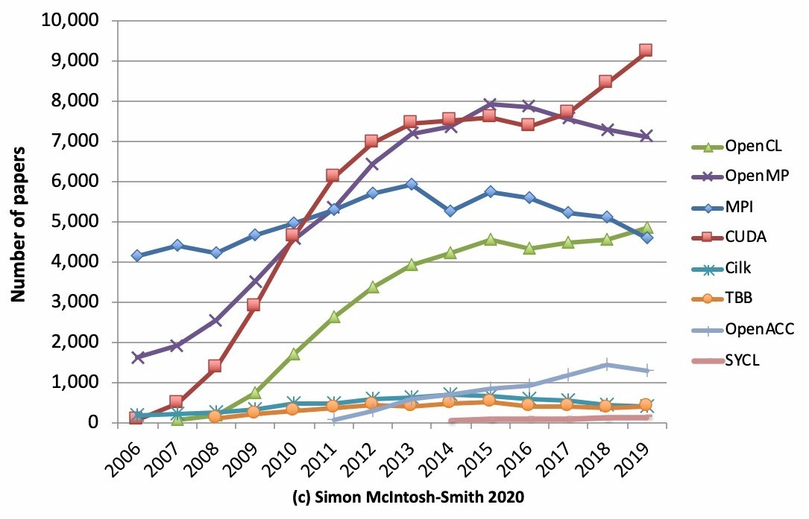
Landscape of computing: The Tower of Babel
Scientific software is divided by:
Performance languages: C, C++, Fortran
High-level productivity languages: Python, Matlab, R
Plethora of programming models for heterogeneous computing . Standard, vendor-specific, third party
Major shift: vendor compiler convergence around LLVM
Slowdown in Moore's Law cadence puts more focus on massively parallel, vectorized computing: Arm CPUs, NVIDIA/AMD/Intel GPU, AI accelerators, TPUs, etc.
AI (industry) + traditional HPC requires powerful reproducible programming abstractions for computation, communication and data
Choosing a programming model is not always a technical decision
https://www.nextplatform.com/2020/04/28/programming-in-the-parallel-universe/

Slide 7
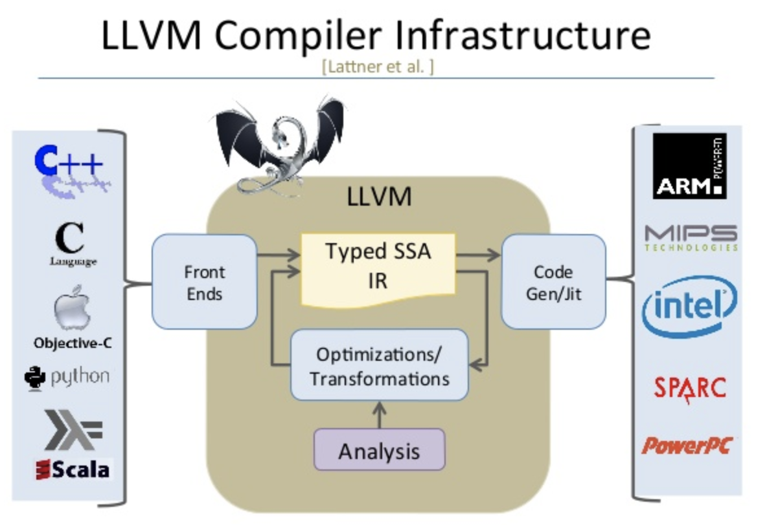
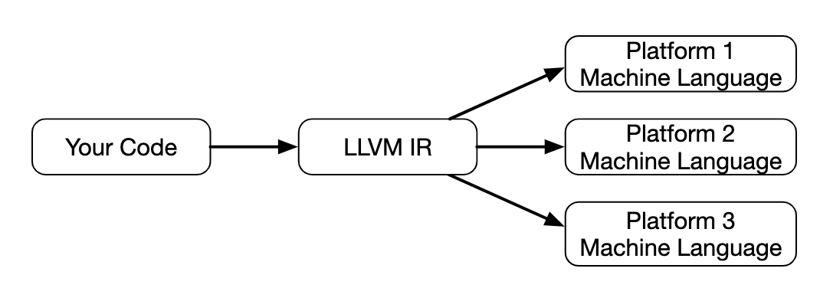
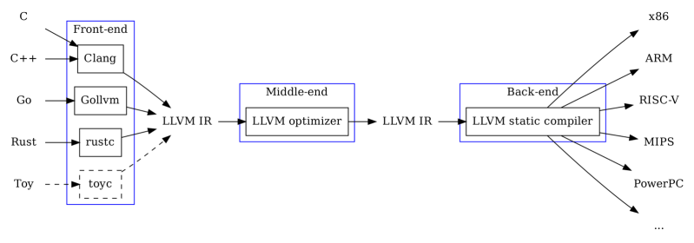
LLVM: a game changer
https://llvm.org/
C. Lattner and V. Adve, "LLVM: a compilation framework for lifelong program analysis & transformation," International Symposium on Code Generation and Optimization, 2004. CGO 2004., 2004, pp. 75-86, https://doi.org/10.1109/CGO.2004.1281665 .
http://www.aosabook.org/en/llvm.html
LLVM Typed Static Single Assignment (SSA) Intermediate Representation (IR) aka LLVM-IR: https://patshaughnessy.net/2022/2/19/llvm-ir-the-esperanto-of-computer-languages
%57 = call %"Array(Int32)"* @"*Array(Int32)@Array(T)::unsafe_build:Array(Int32)"(i32 610, i32 2), !dbg !89

Slide 8

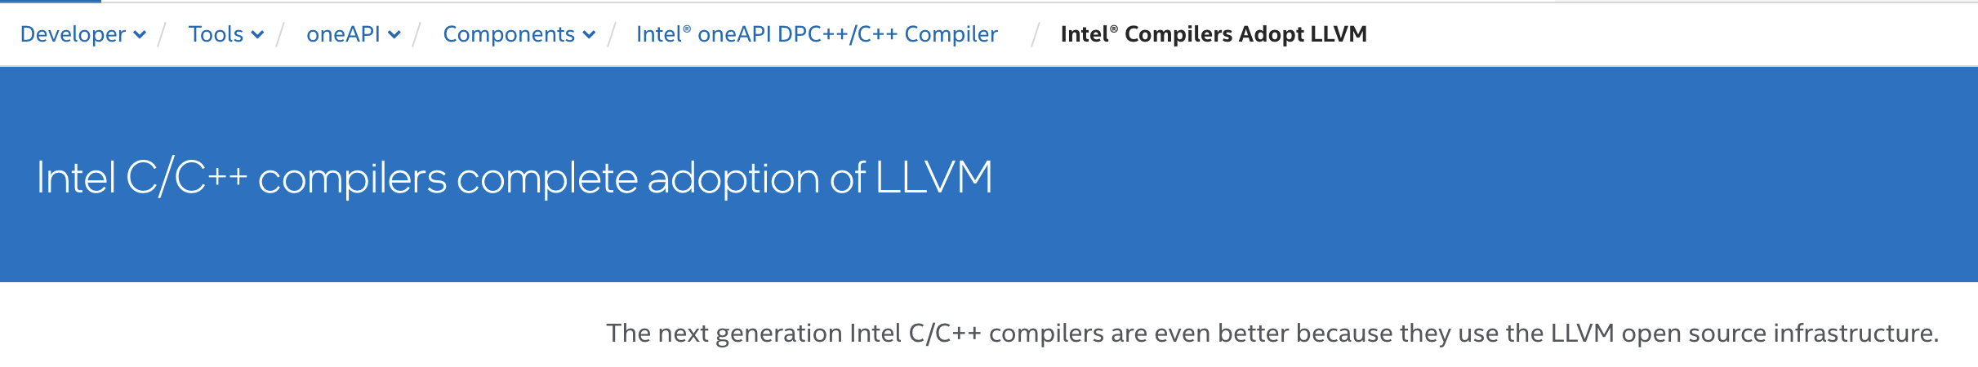
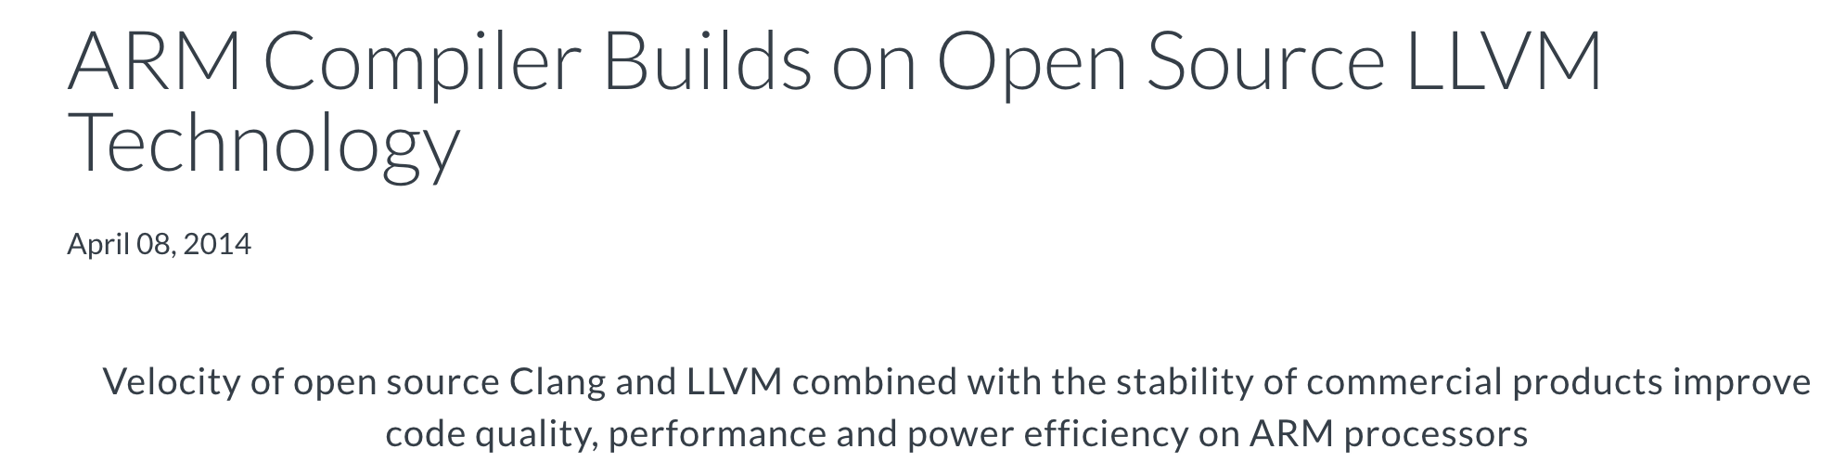

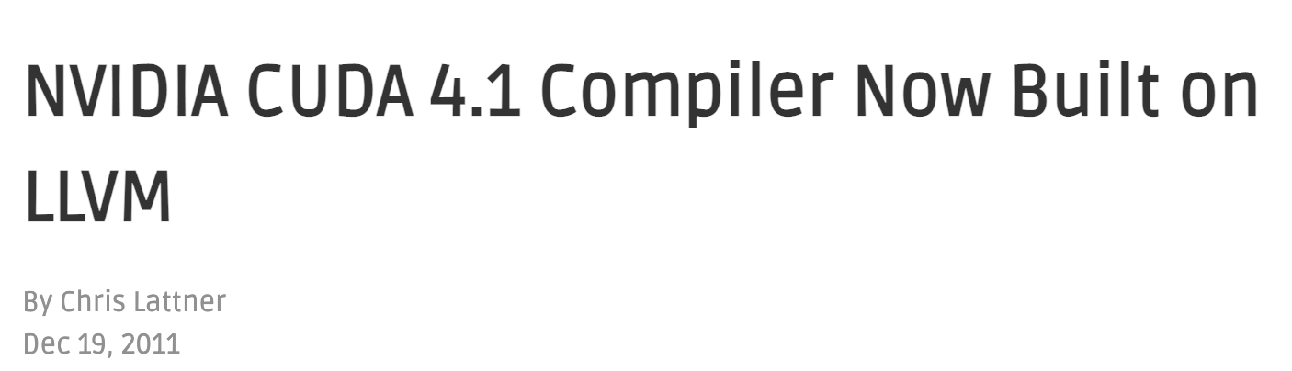
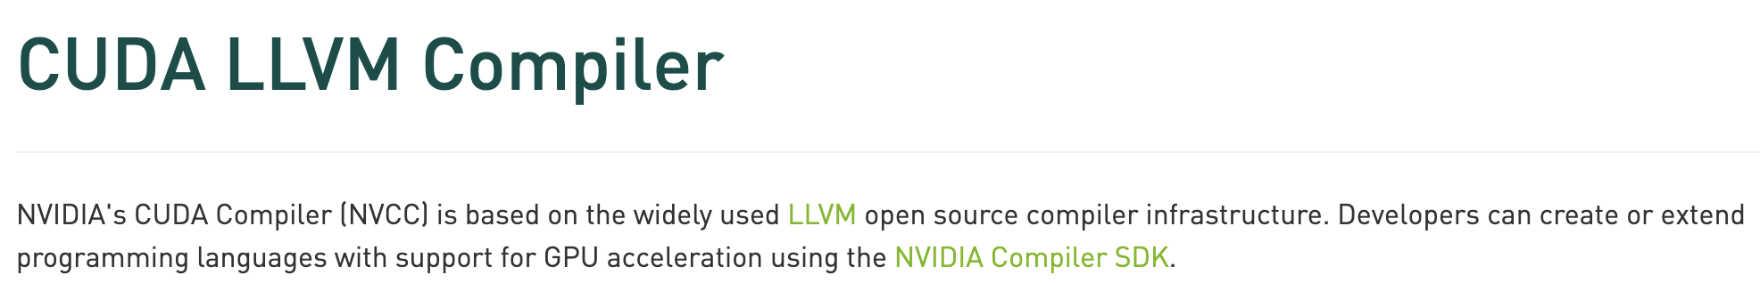
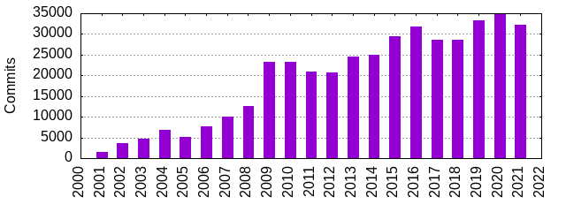
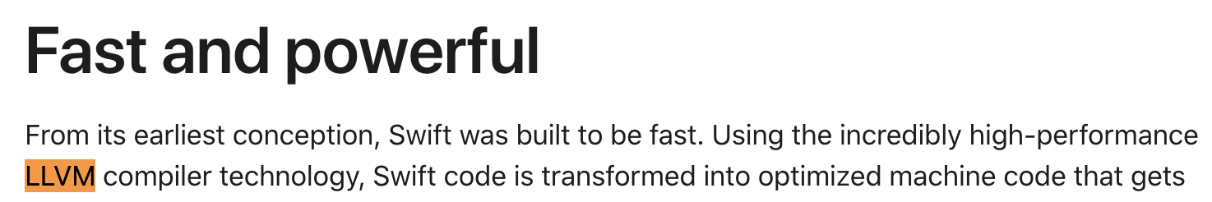
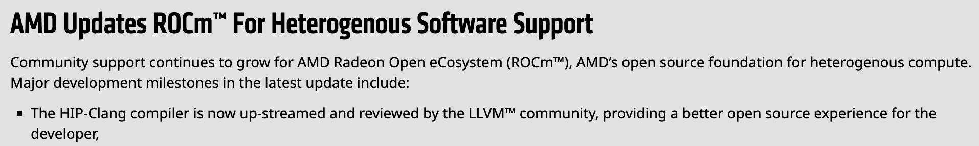
LLVM: Vendor and programming model adoption
Intel
https://www.ornl.gov/project/proteas-tune
ARM
https://csmd.ornl.gov/project/clacc
https://openmp.llvm.org
NVIDIA
LLVM Commits
Apple
AMD

Slide 9


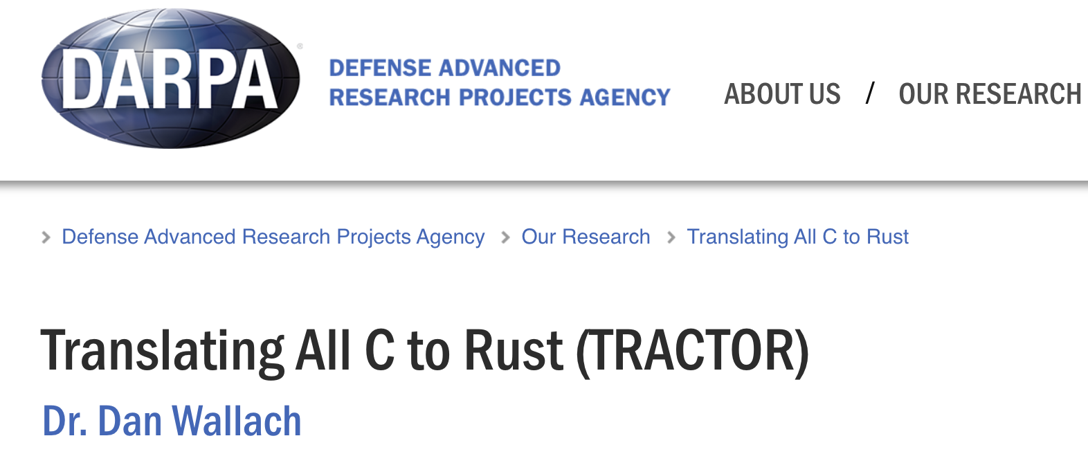
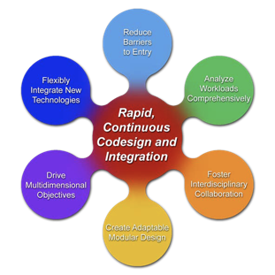
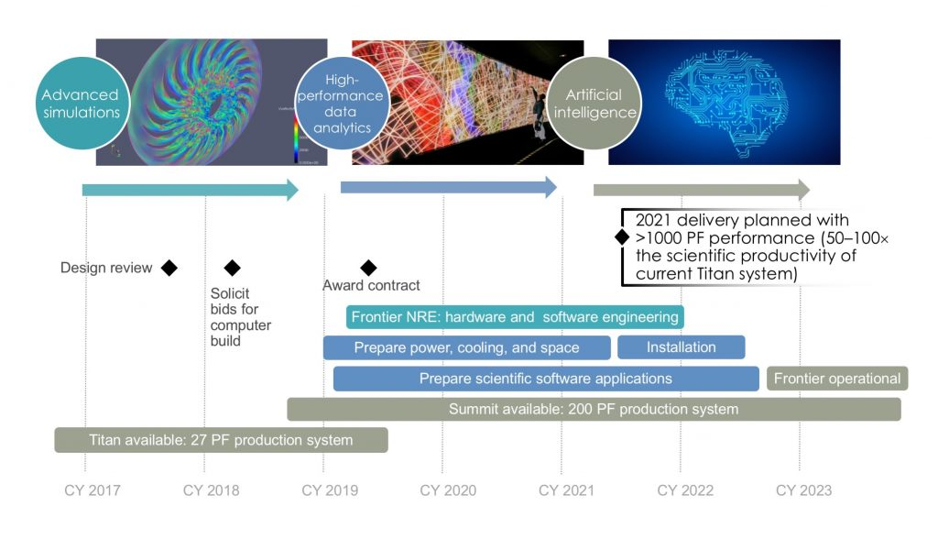
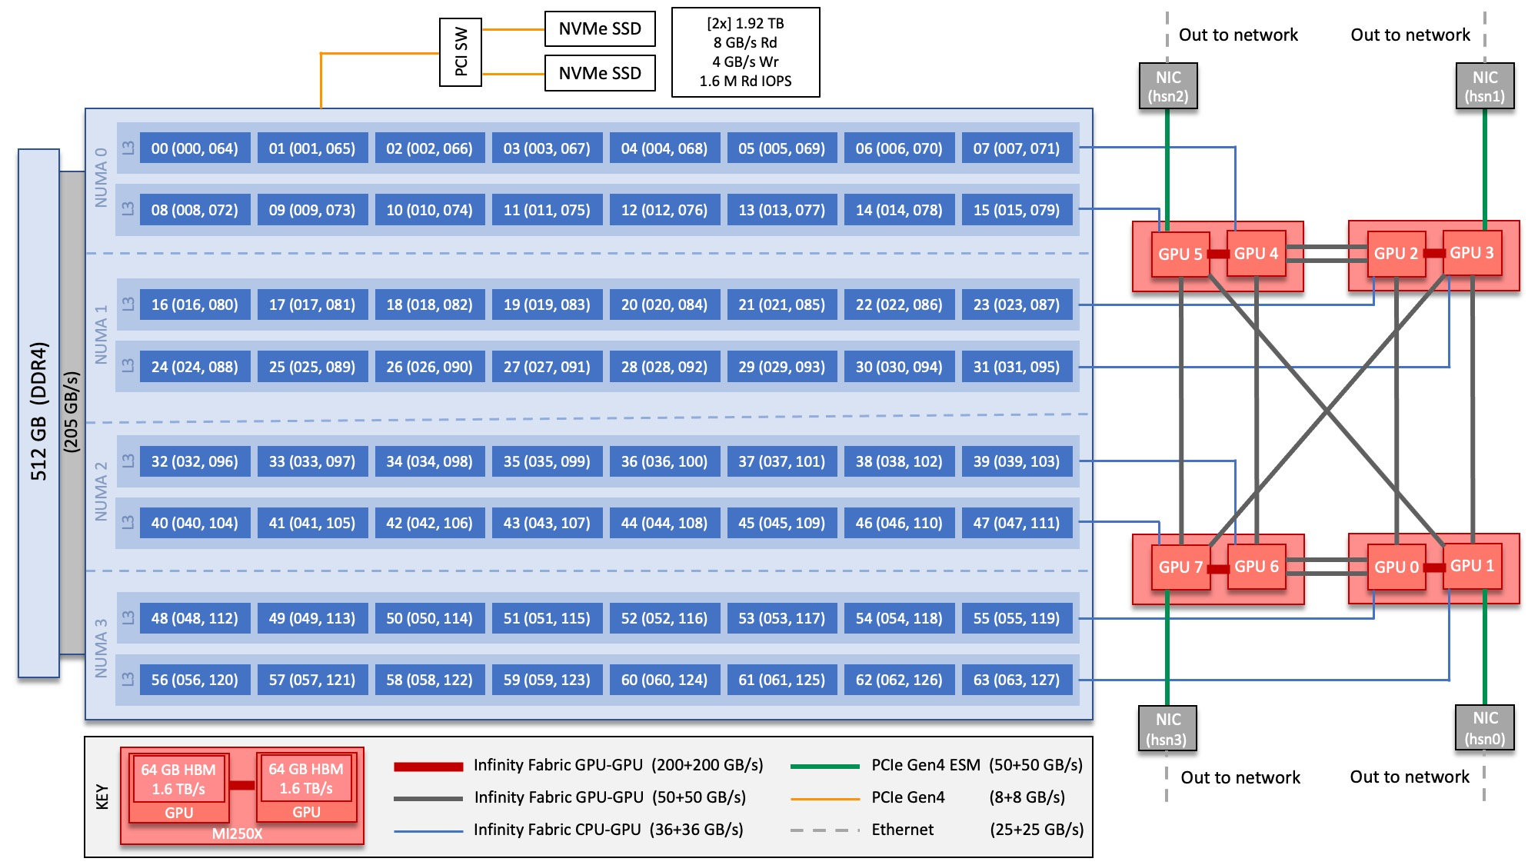
Rethink how we do Computing
Scientific programming is HARD (specially on our Leadership Computing Facilities, LCFs)
Software is our “specialized science equipment” for science that needs to be stewarded and advanced
“Can a machine translate a sufficiently rich mathematical language into a sufficiently economical program at a sufficiently low cost to make the whole affair feasible?”--------------------------- Backus on Fortran (1980)
Programming productivity is always a challenge
Barrier to entry from idea to portable performance
Integrate AI (industry)+HPC (government)
How to leverage legacy codes?
Key question: “What novel approaches to software design and implementation can be developed to provide performance portability for applications across radically diverse computing architectures?” from Reimagining Codesign for Advanced Scientific Computing: Unlocking Transformational Opportunities for Future Computing Systems for Science. DOE Report https://doi.org/10.2172/1822198

Slide 10
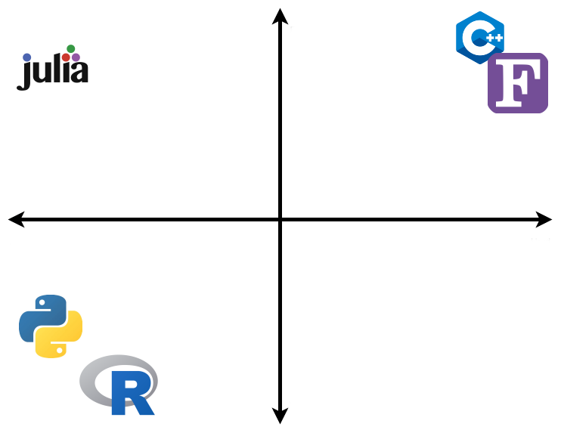

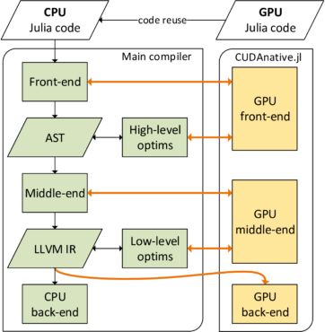
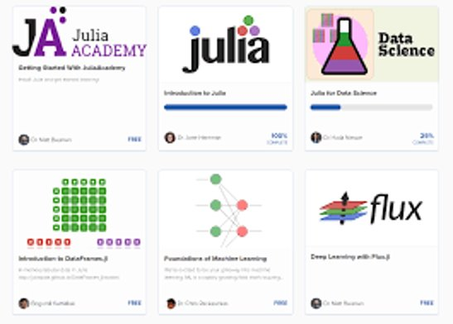

Julia's value proposition for science
Designed for “scientific computing” (Fortran-like) and “data science” (Python-like) with performant kernel code via LLVM compilation
Lightweight interoperability with existing Fortran and C libraries
Julia is a unifying workflow language with a coordinated ecosystem
Fast
Easy
Hard
“Julia does not replace Python, but the costly workflow process around Fortran+Python+X, C+X, Python+X or Fortran+X (e.g. GPUs, simulation + data analysis)”
where X = { conda, pip, pybind11, Cython, Python, C, Fortran, C++, OpenMP, OpenACC, CUDA, HIP, CMake, numpy, scipy, Matplotlib, Jupyter, …}
Slow
https://juliadatascience.io/
Rich data science
ecosystem
LLVM
Pkg.jl
https://pde-on-gpu.vaw.ethz.ch/lecture7
https://developer.nvidia.com/blog/gpu-computing-julia-programming-language/
https://quantumzeitgeist.com/learning-the-julia-programming-language-for-free/

Slide 11



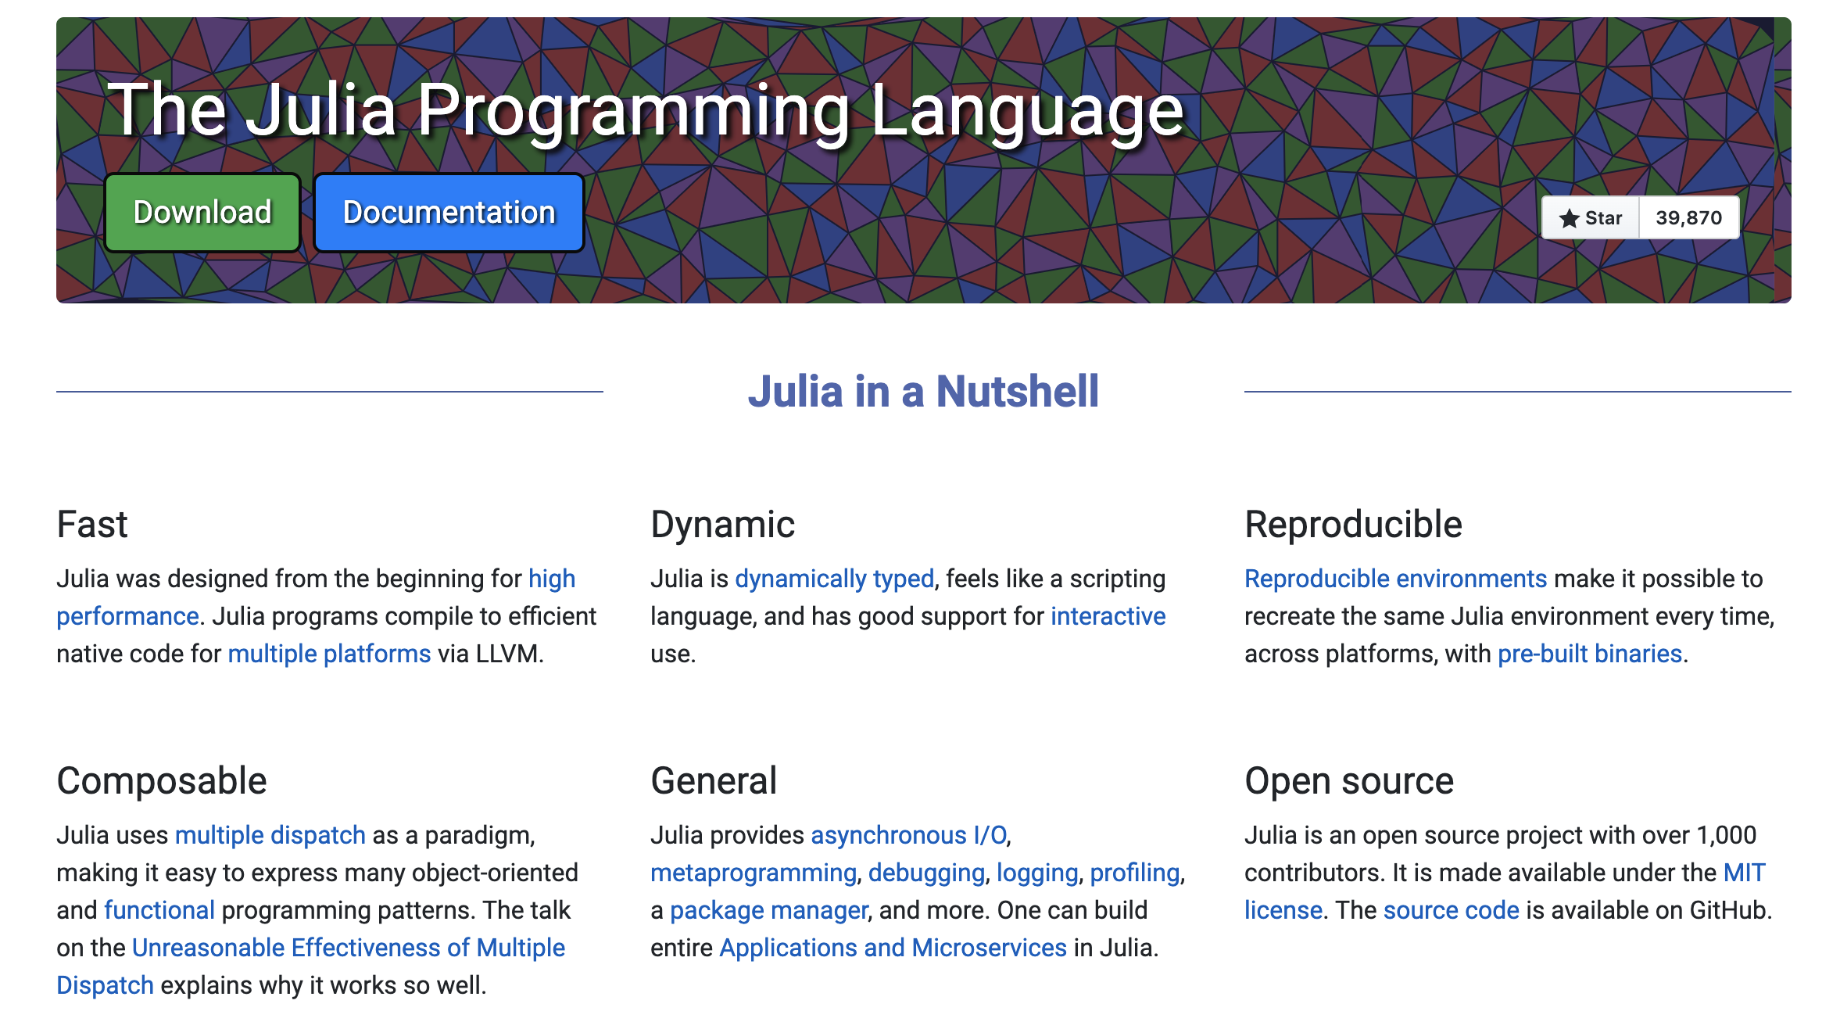
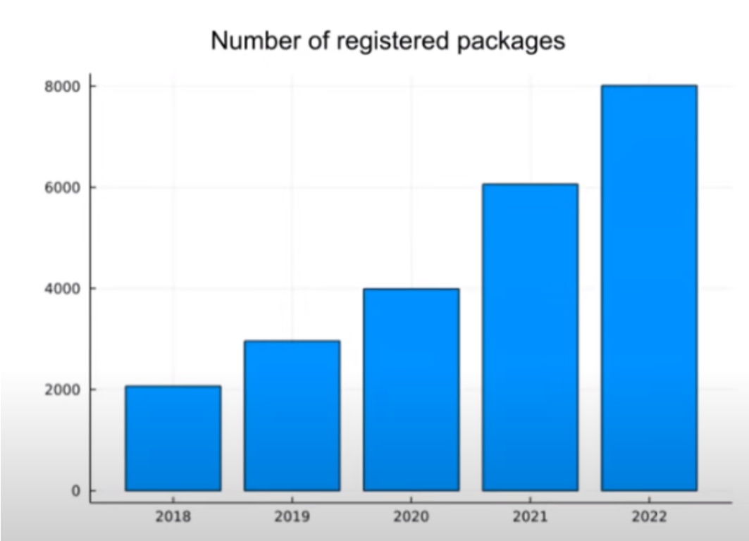
Julia Brief Walkthrough
History: started at MIT in the early 2010s (predates Python Numba) https://julialang.org/blog/2022/02/10years/
JuliaHub (formely Julia Computing) and MIT are major contributors: https://info.juliahub.com/case-studies
First stable release v1.0 in 2018, v1.10 as of 2024 https://julialang.org/
Open-source GitHub-hosted packages and ecosystem with MIT permissive license: https://github.com/JuliaLang/julia
Community: annual JuliaCon summer conference: https://juliacon.org/2024/
95% of Julia packages in the registry had some form of CI (youtube.com/watch?v=9YWwiFbaRx8)

Slide 12
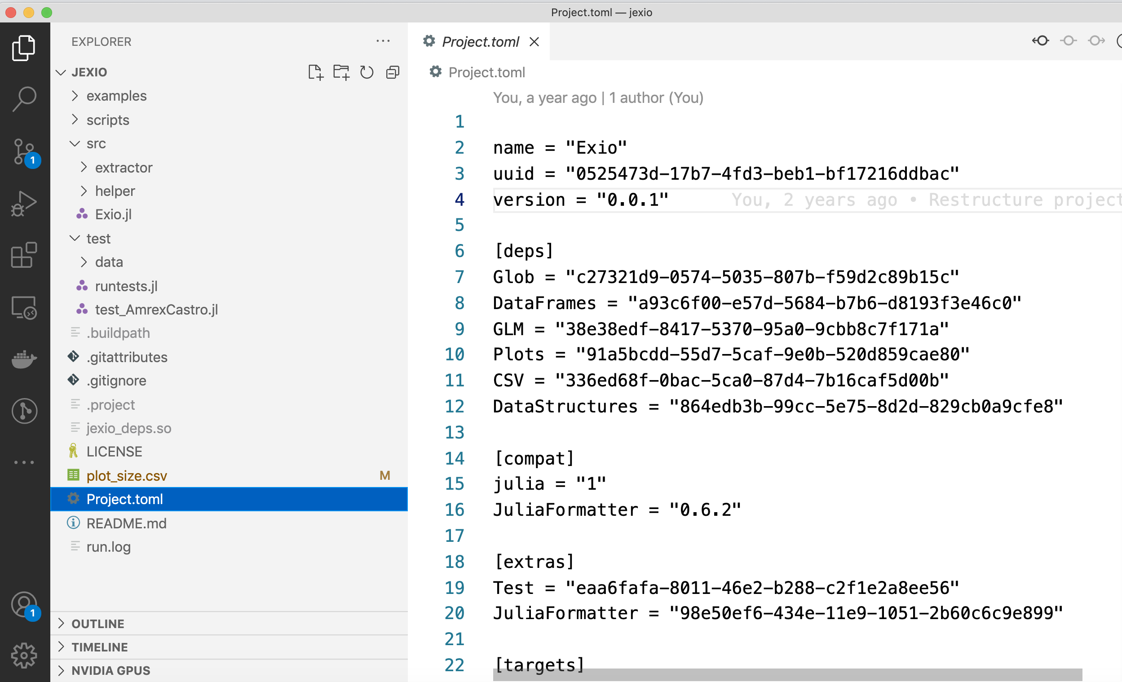
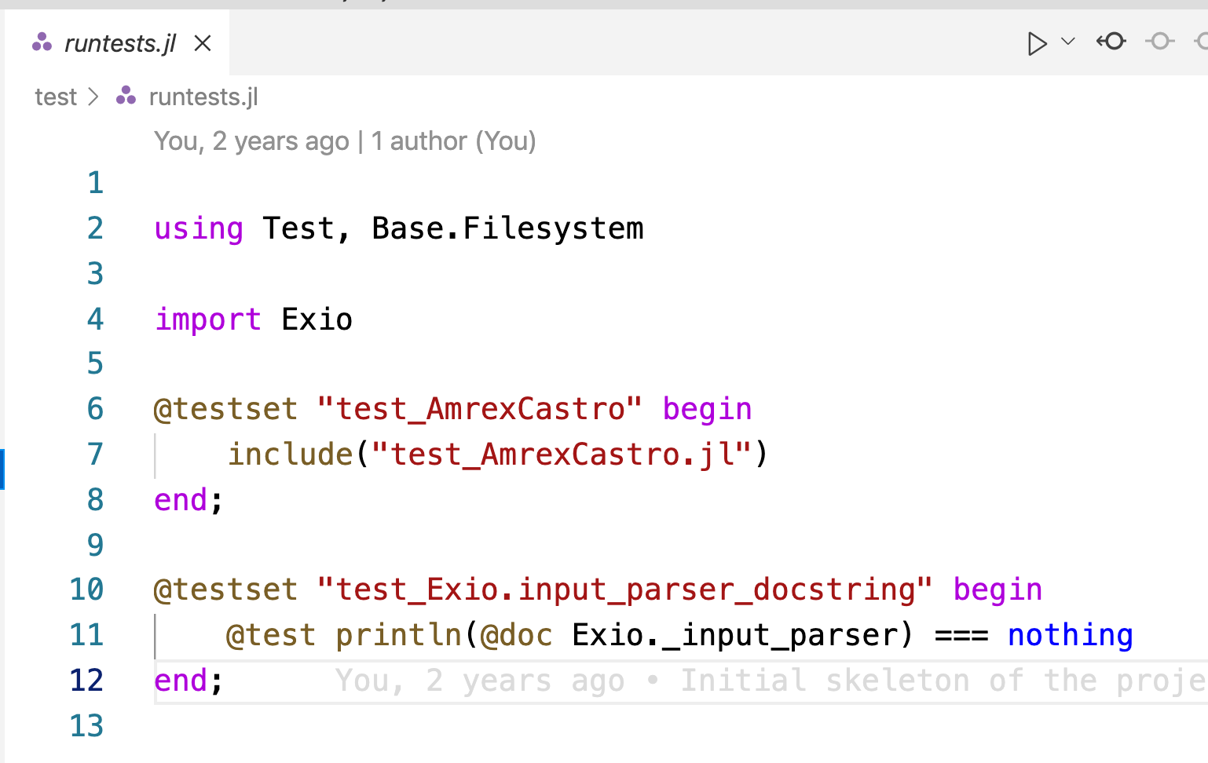
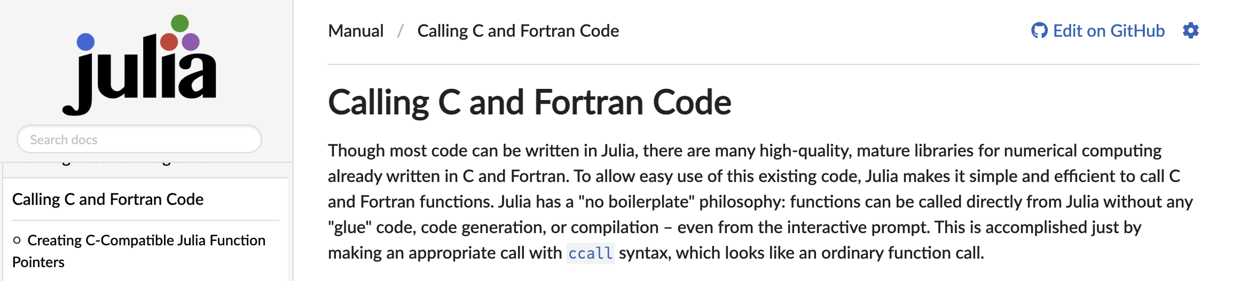
Julia Brief Walkthrough
Reproducibility is in the core of the language:
- Interactive: Jupyter, Pluto.jl
- Packaging Pkg.jl
- Environment Project.toml
- Testing Test.jl
Just-in-time or Ahead-of-time compilation with PackageCompiler.jl
Powerful metaprogramming for code instrumentation: @profile, @time, @testset, @test, @code_llvm, @code_native, @inbounds,
Interoperability is key: @ccall, @cxx, PyCall, CxxWrap.jl
https://github.com/ornl-training/julia-basics
Notes:
To the terminal

Slide 13
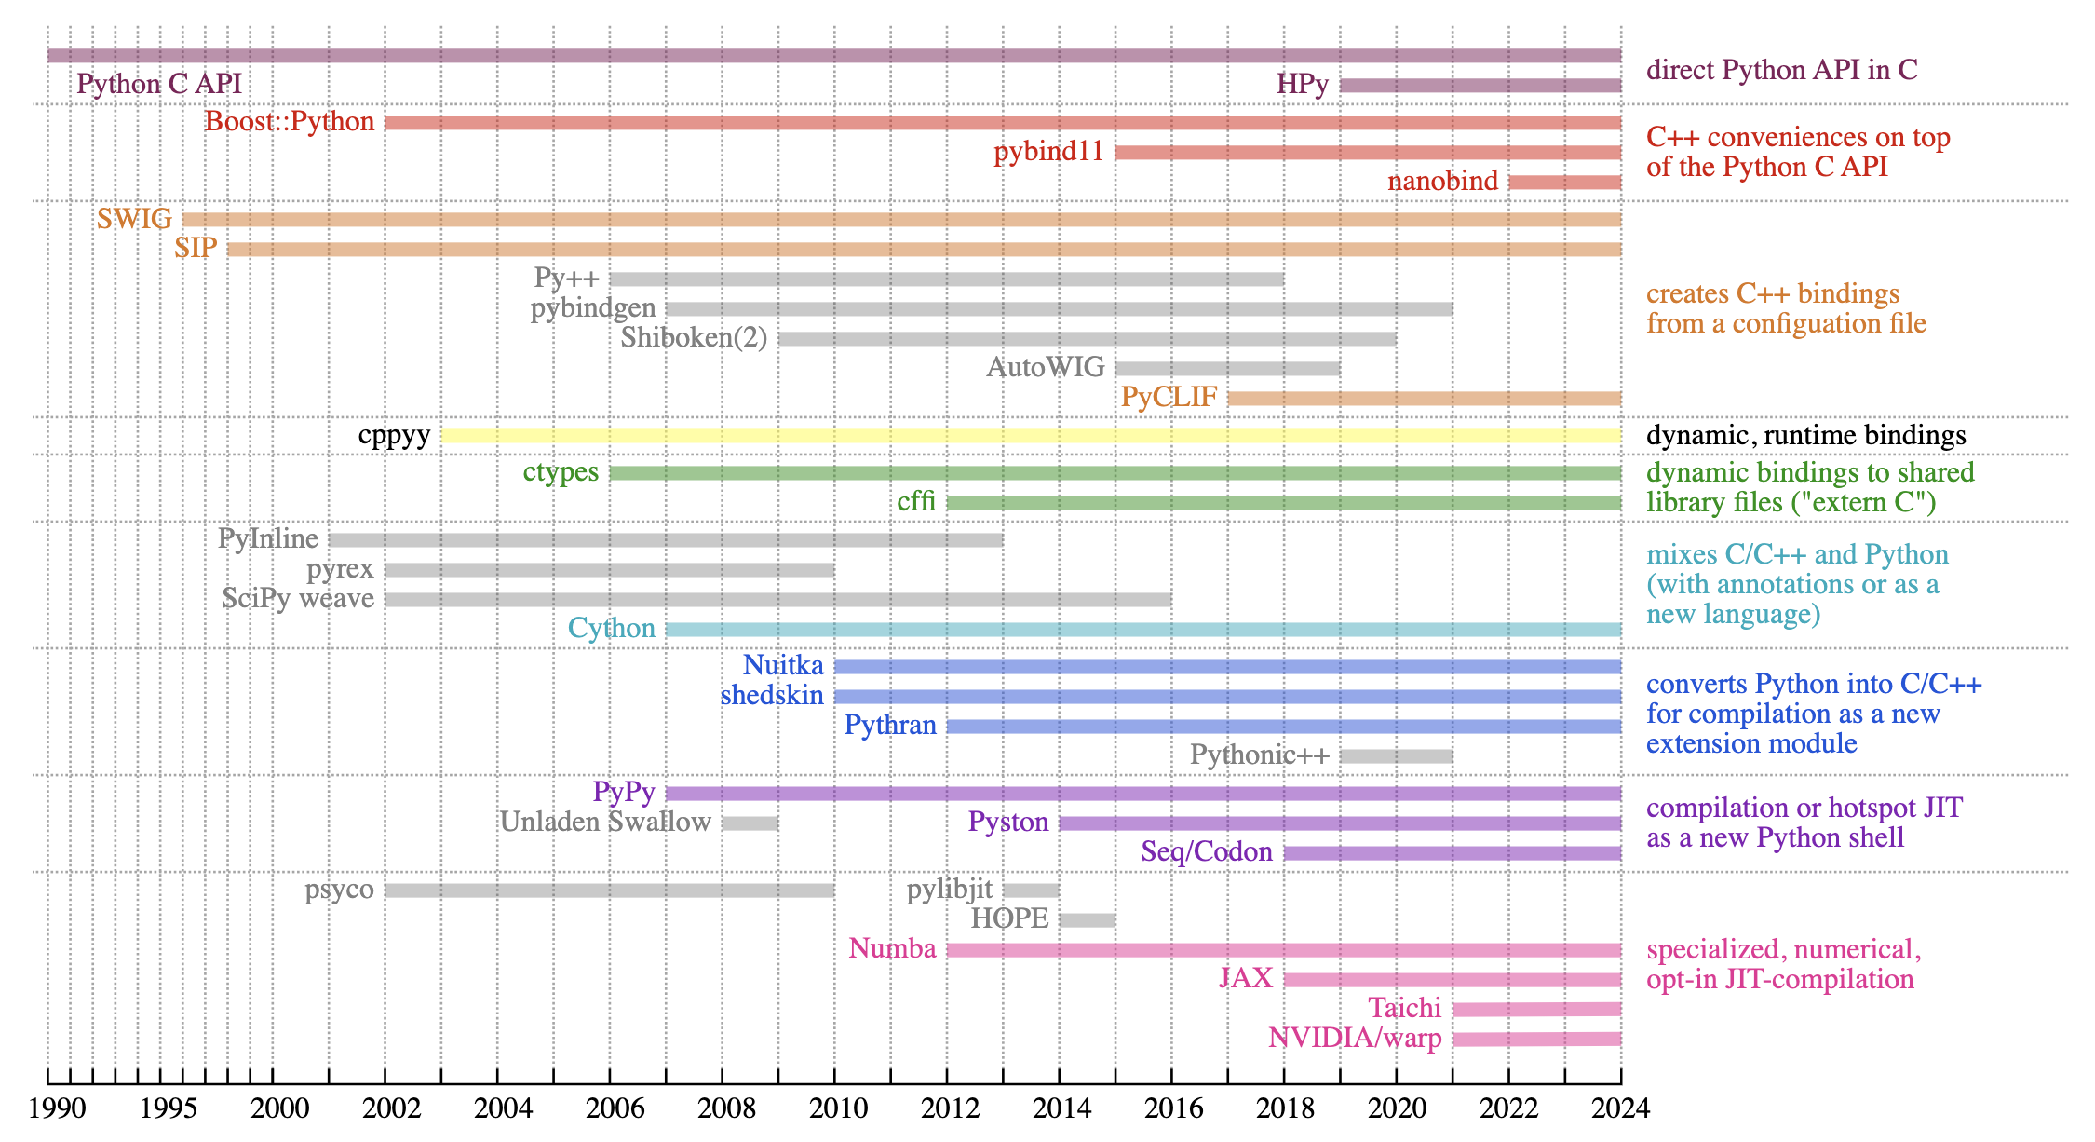
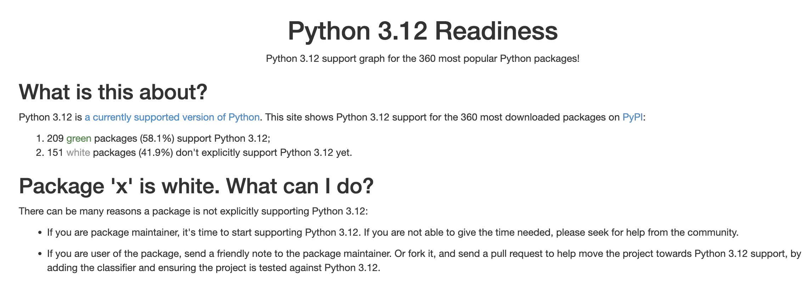
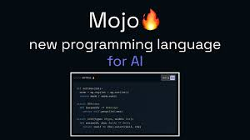
When Python is not enough…and it’s a fragmented world
Making Python “faster”
https://pyreadiness.org/3.12/
https://raw.githubusercontent.com/jpivarski-talks/2023-05-01-hsf-india-tutorial/main/img/history-of-bindings-2.svg

Slide 14

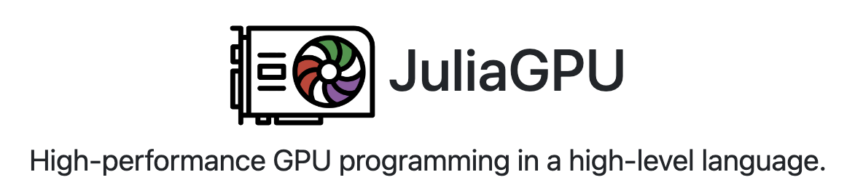
In a Nutshell…Why Julia??
Think in Python/Fortran, but now imagine that it works “well” on HPC
A JIT “technical” language on top of LLVM
Easy-to-use and agile interface with expected performance
Julia syntax is for Science and is Open Source
Native syntax (no manual implemented wrappers of wrapper of …) for HPC support, e.g. www.juliagpu.org
Threads, CUDA, AMDGPU, OneAPI, MPI, DAGGER, etc.
Interoperability: C and Fortran, support for AI: FluxML
Integrated and efficient support for packaging, reproducibility, CI/CD, …
All this makes Julia’s ecosystem and community motivated by performance and productivity -> e.g. rapid prototyping, “throw-away” code, scientific CPU/GPU access, HPC stack
https://julialang.org/

Slide 15
Why NOT Julia??
Existing large investments in other languages
Long-term ROI: Package support? Stable not standard
Ecosystem is not mature: Tooling? (HPC)
Out of scope for my application needs
I’m simply more comfortable in another language
https://julialang.org/

Slide 16
Contents
Julia’s value proposition for science: LLVM + Coordinated Ecosystem
Research efforts in HPC
Community efforts
JACC.jl performance portability in Julia
Summary and Acknowledgements
https://pde-on-gpu.vaw.ethz.ch/lecture7
https://scientificcoder.com/my-target-audience

Slide 17
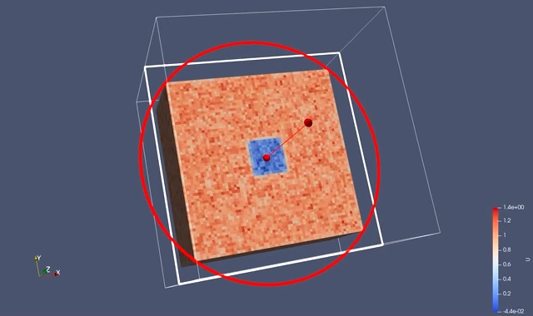
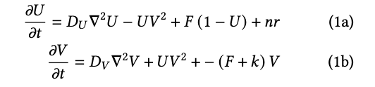
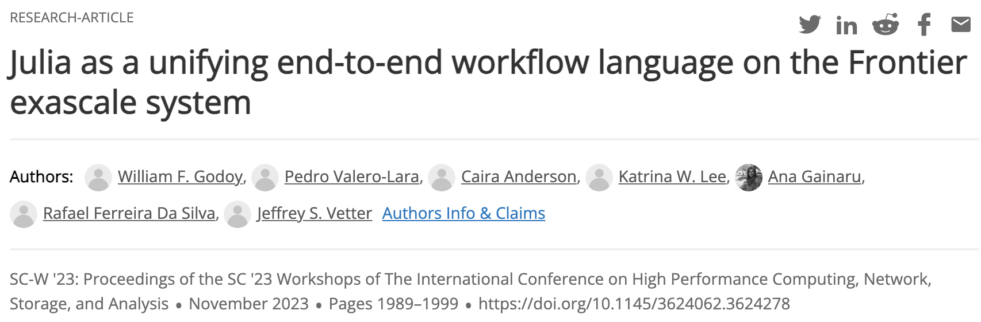
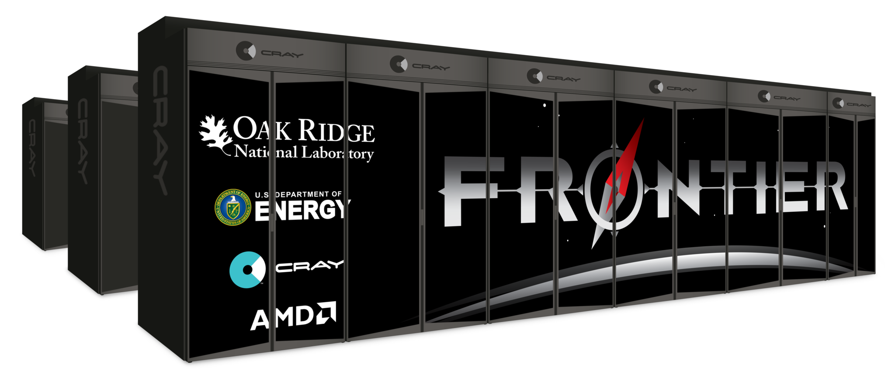
Gray-Scott app: https://github.com/JuliaORNL/GrayScott.jl
Simple 3D 2-variable diffusion-reaction solver
CPU Threads, CUDA.jl and AMDGPU.jl backends using multiple dispatch
Parallel I/O ADIOS2, can be visualized with ParaView
MPI.jl for communication
Configuration and job scripts for Frontier, Crusher and Summit under ./scripts/
Data analysis on JupyterHub
Best paper at SC23 WORKS
Research question: Can I write an entire HPC ”hard-coupled” workflow in Julia?
https://doi.org/10.1145/3624062.3624278
https://www.nextplatform.com/2023/09/26/julia-still-not-grown-up-enough-to-ride-exascale-train/
Notes:
Vendor gaps

Slide 18
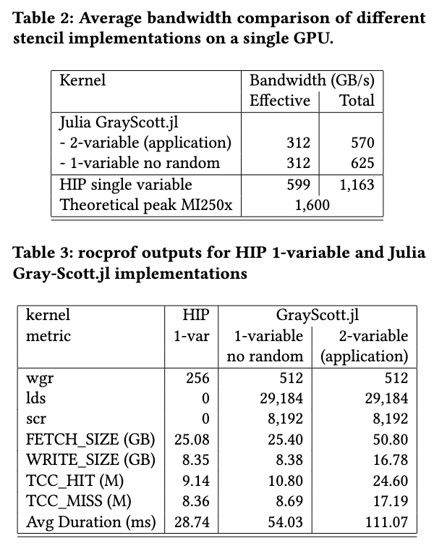
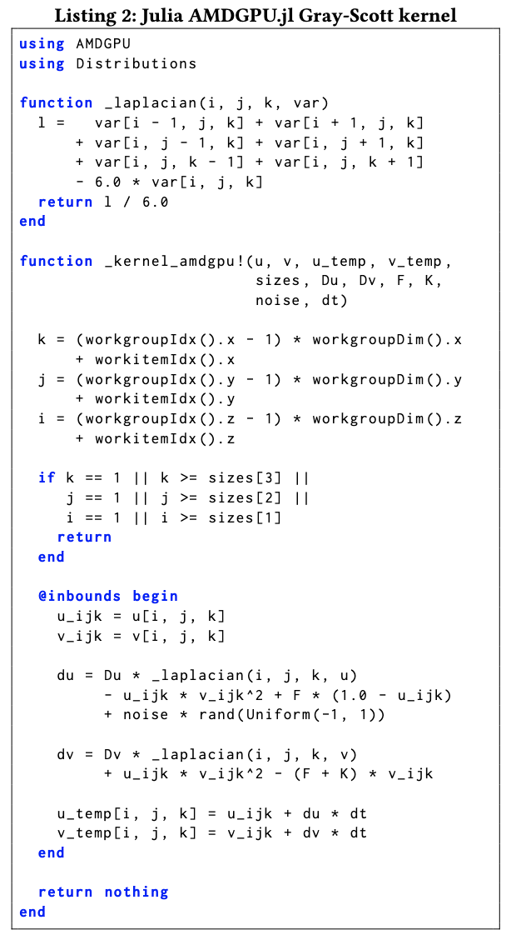
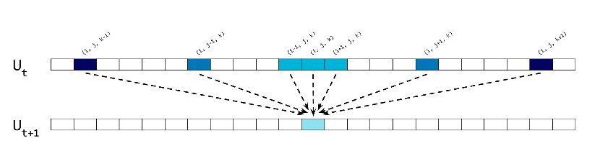
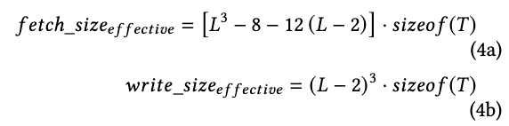
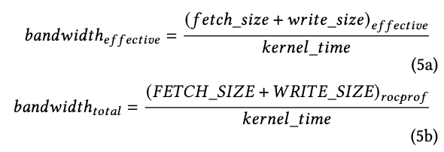
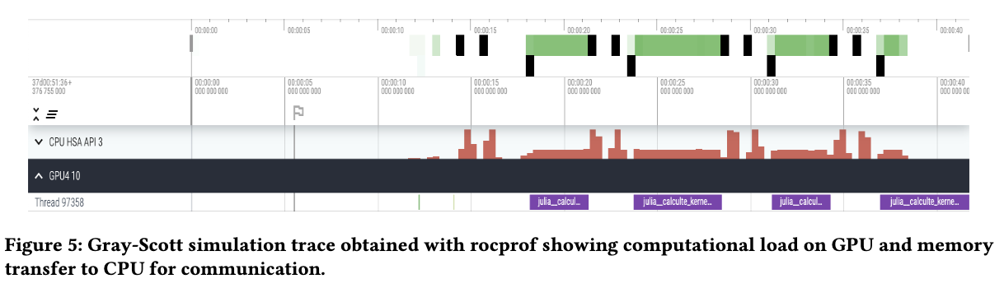
Frontier on-node scalability using AMDGPU.jl
7-point stencil
Notes:
Vendor gaps

Slide 19
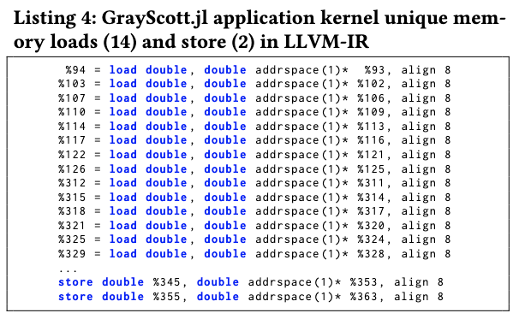
Frontier on-node scalability using AMDGPU.jl
7-point stencil
Julia AMDGPU.jl reaches ~50% bandwidth (performance) of HIP
No surprises on: FETCH/WRITE SIZE, LLVM-IR
rocprof reports more activity “lds” on Julia
Notes:
Vendor gaps

Slide 20
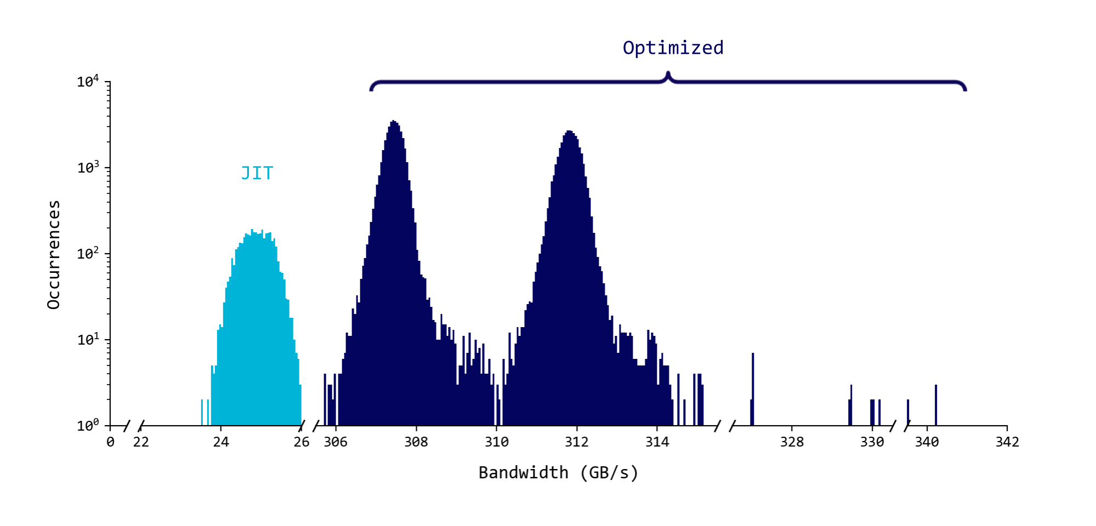
Frontier on-node scalability using AMDGPU.jl for several GPUs
Bandwidth distribution for 4,096 GCD (GPUs) and 20 timesteps. HIP ~ 600 GB/s (800 GB/s claimed on MI250x), Theoretical Peak on MI250x = 1,600 GB/s
Notes:
Vendor gaps

Slide 21
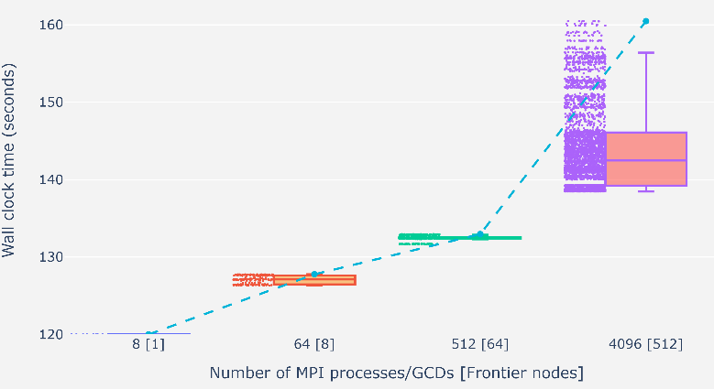
GrayScott.jl Weak Scaling on Frontier
Tested successfully up to 512 nodes (5% of Frontier) 1 GCD/MPI proc using MPI.jl
Tried 4K nodes (50% of Frontier) resulted in a libfabric error
2-3% variability up to 64 nodes
12-15% variability at 512 nodes
Notes:
Vendor gaps

Slide 22
GrayScott.jl Parallel I/O Weak Scaling on Frontier file system
We tested parallel I/O using Julia via the ADIOS2.jl Julia bindings
ADIOS2 is a high-performance data I/O library funded by the US Department of Energy ASCR (+ GE?)
Results are shown for the Orion file system
ADIOS2.jl shows negligible overhead wrt ADIOS2
Godoy, W. F., Podhorszki, N., Wang, R., Atkins, C., Eisenhauer, G., Gu, J., Parashar M, ... & Klasky, S. (2020). Adios 2: The adaptable input output system. a framework for high-performance data management. SoftwareX, 12, 100561. https://doi.org/10.1016/j.softx.2020.100561
Notes:
Vendor gaps

Slide 23
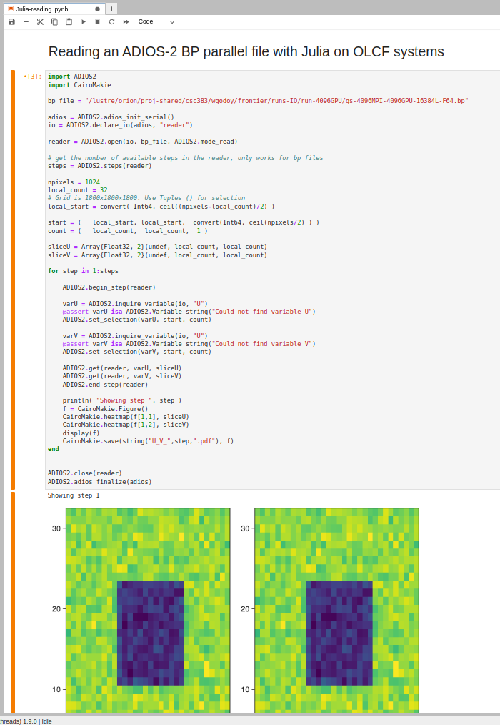
Data analysis on JupyterHub at OLCF
https://jupyter.olcf.ornl.gov/
We launched a Julia kernel on JupyterHub to read and analyze data
We read with ADIOS2.jl and visualize with Makie.jl
JIT and TTFX (time to first plot) can be a nuance
Pluto.jl?
Godoy, W. F., Podhorszki, N., Wang, R., Atkins, C., Eisenhauer, G., Gu, J., Parashar M. ... & Klasky, S. (2020). Adios 2: The adaptable input output system. a framework for high-performance data management. SoftwareX, 12, 100561. https://doi.org/10.1016/j.softx.2020.100561
Notes:
Vendor gaps

Slide 24
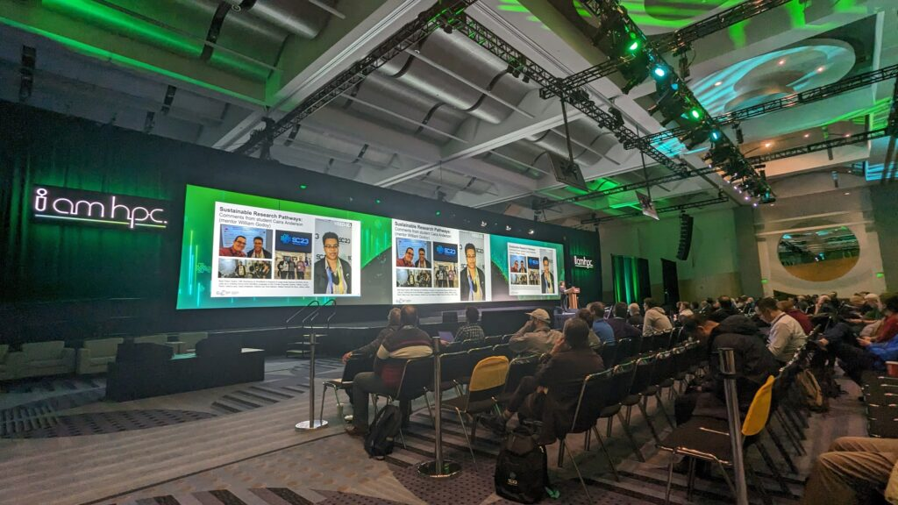
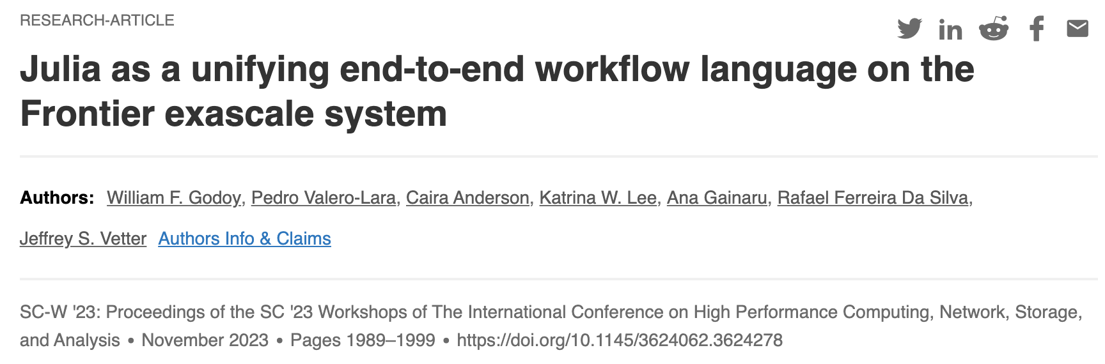
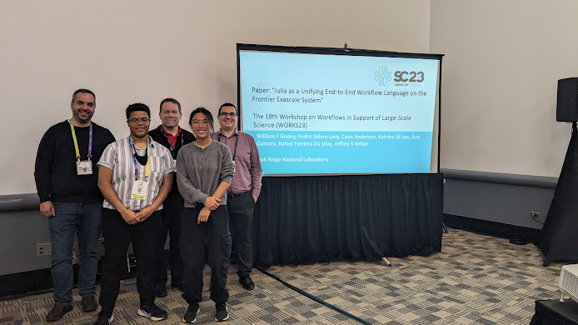



Research efforts: Impact
https://www.youtube.com/watch?v=E2a7jXFp21Y&t=1590s
Can we make HPC more accessible?
Investigate new approaches in the post-ECP landscape: Julia for HPC, LLMs for HPC
Enabled me to mentor in our internship program for the last 3 years (Intern got prestigious DOE CGSF fellowship and share her story at SC23 main stage)
Build a “Julia for HPC” community https://juliaparallel.org/resources/
Explore LLMs for scientific languages
https://shinstitute.org/srp-mentor-spotlight
Highlights:
Building Julia for HPC research and community activities: tutorials, papers, SC BoFs 22/23, SC24 Tutorial
2023 IPDPS HIPS workshop paper
2023 ICPP P2S2 paper on generative AI for HPC kernels
Best Paper at the SC23 WORKS workshop

Slide 25



ChatHPC: upcoming ASCR AI4S Durban and Prod AI-Ass HPC SW Projects
Automatic Parallelization
AMDGPU and OneAPI (maybe others like MPI, DAGGER, …)
Automatic Translation
LLM Agents
Training (fine-tuning) of Specific HPC targets
Algorithms
Optimizations
Involve other languages
Fortran, C, C++, Python, …
Involve other tools
Profilers, Libraries, Models
Initial evaluation
https://doi.org/10.1002/cpe.8269

Slide 26


Code/Kernel Generation (CUDA)

Slide 27


Automatic Parallelization
Do you see anything weird in the code?
The function warp_reduce_sum is not necessary (hallucination?)
The code is functional despite this

Slide 28
Contents
Julia’s value proposition for science: LLVM + Coordinated Ecosystem
Research efforts in HPC
Community efforts
JACC.jl performance portability in Julia
Summary and Final Thoughts
https://pde-on-gpu.vaw.ethz.ch/lecture7
https://scientificcoder.com/my-target-audience

Slide 29






Julia Community Efforts
Building WORKFORCE?
External Engagements with Julia HPC
Monthly meetings with stakeholders
JuliaCon 2022/2023 HPC minisymposium
Julia HPC Position paper
ECP BoF Session on Rapid Prototyping for HPC using Julia, Python Numba, Flang
SC22/23 BoF “Julia for HPC”
OLCF/NERSC/SNS Tutorials June 2024 ~100 registrations
Upcoming SC24 1st Julia for HPC Tutorial
Paper accepted at SC24 WACCPD
Best poster nomination at SC24
Internal Engagements
Tutorials at ORNL Software and Data Expo
Julia Workshop for ORNL Science
OLCF User Call: Julia for HPC
SC22
SC23
Notes:
Add external collaborators

Slide 30







Community Efforts in HPC: more frameworks written in Julia
HPC “backends”:
https://juliagpu.org/: AMDGPU.jl , CUDA.jl OneAPI.jl , Metal.jl
KernelAbstractions.jl, JACC.jl
MPI.jl
Threads (part of Base)
ADIOS2.jl , HDF5.jl
Monthly HPC Call (Valentin Churavy, MIT)
Porting miniWeather App to Julia (Youngsung Kim, Hyun Kang, and Sarat Sreepathi, CSED)
Julia + Sunway + QC at SC22
https://github.com/omlins/julia-gpu-course
Top15 most popular packages
https://enccs.github.io/Julia-for-HPC
https://sciml.ai/
General Atomics:
https://github.com/ProjectTorreyPines
ECP ExaSDG on Summit
https://github.com/CliMA
https://github.com/SunnySuite/Sunny.jl
https://docs.dftk.org/stable
https://juliaastro.github.io/dev
https://github.com/JuliaParallel
Notes:
Vendor gaps

Slide 31



First Julia for ORNL Science Workshop 2022
First event in 2022: 101 registrations, 60 in-person, 51 virtual
1 morning tutorial, working lunch,12 lightning talks
Event website: https://ornl.github.io/events/jufos2022/
2022: COVID, ECP…Frontier? LLM? ChatGPT?

Slide 32


Second Julia for ORNL Science Workshop 2024
July workshop: 115 registrations, 75 in-person, 40 virtual, 15 talks
Event Website: https://ornl.github.io/events/jufos2024/
Goals:
Build community (learn, meet people, share your work)
Opportunities for ORNL science

Slide 33








Second Julia for ORNL Science Workshop 2024
Showcased science use-cases and heterogeneous HW
https://www.graphcore.ai/posts/running-julia-on-graphcore-ipus

Slide 34
Contents
Julia’s value proposition for science: LLVM + Coordinated Ecosystem
Research efforts in HPC
Community efforts
JACC.jl performance portability in Julia
Summary and Final Thoughts
https://pde-on-gpu.vaw.ethz.ch/lecture7
https://scientificcoder.com/my-target-audience

Slide 35

JACC.jl (Julia ACCelerated), What is that??
Think in Kokkos, but now imagine that it is easy to use
The metaprogramming and performance portability model of Julia
One “parallel_for” code running everywhere
JACC is a unified Julia front-end in top of multiple backends
Threads (CPUs), CUDA (NVIDIA GPUs), AMDGPU (AMD GPUs), and OneAPI (Intel GPUs)
Hide low-level and device specific implementation
Memory, granularity, etc.
Improve programming productivity for Science and HPC
A growing community (family)
BNL(NERSC), Argonne, MIT, ETHZ, FI/CCQ, …
You are welcome to join (JACC meetings once a month)
https://github.com/JuliaORNL/JACC.jl

Slide 36

JACC model, How to use it??
Descriptive, not prescriptive
Two main components
JACC.Array, high-level: JACC.ones or JACC.zeros
An alias to the corresponding backend memory management
JACC.parallel_for and JACC.parallel_reduce
Kernel passed an argument
Uni-dimensional and bi-dimensional APIs
JACC.shared
Exploit in-chip programable GPUs shared memory
https://github.com/JuliaORNL/JACC.jl

Slide 37


How is JACC implemented??
The simpler the better, use everything that Julia can provide
One implementation per backend
https://github.com/JuliaORNL/JACC.jl

Slide 38













OK, but this is HPC, What about performance??
Julia as a unifying end-to-end workflow language on the Frontier exascale system. SC WORKS 2023
Evaluating performance and portability of high-level programming models: Julia, Python/Numba, and Kokkos on exascale nodes. IPDPS HIPS 2023
Accepted at SC24 WACCPD

Slide 39










Ongoing efforts??
Accepted at IEEE HPEC24
JACC.Shared
Exploiting high-bandwidth programable in-chip GPUs memory
https://github.com/JuliaORNL/JACC.jl

Slide 40




Ongoing JACC efforts
Accepted at SC24 WACCPD
JACC.experimental
A separate JACC module to explore new ideas
Once the ideas are well implemented, these can be “promoted”
JACC.shared
JACC.BLAS
BLAS library on top of JACC
Extend JACC to math libraries
Working on BLAS level-1/2 routines
JACC.multi
Support for multi-device
JACC.auto
Support for auto-tuning
Task-based
DAGGER.jl
IRIS - R&D100
Best ORNL CS intern poster by Kelly Tang
Nominated for Best Poster at SC24
Accepted at SC24 AI4Science
SC24: Julia for HPC 1st Tutorial and 3rd BoF w/ MIT and LBNL
https://github.com/JuliaORNL/JACC.jl

Slide 41




Ongoing JACC efforts: facilities
Integrated Research Infrastructure: provide an accessible performance portable ecosystem
CPU only workflows -> CPU/GPU on HPC systems
Accepted at SC24 XLOOP

Slide 42
Contents
Julia’s value proposition for science: LLVM + Coordinated Ecosystem
Research efforts in HPC
Community efforts
JACC.jl performance portability in Julia
Resources
Summary and Acnowledgements
https://pde-on-gpu.vaw.ethz.ch/lecture7
https://scientificcoder.com/my-target-audience

Slide 43

Where to get started?
Pick a gentle tutorial: https://techytok.com/from-zero-to-julia/
https://github.com/ornl-training/julia-basics (training by WF Godoy & Philip Fackler) OLCF Tutorial: https://juliaornl.github.io/TutorialJuliaHPC/applications/GrayScott/01-Solver.html
Use VS Code as the official IDE + debugger
JuliaCon talks are available on YouTube
https://discourse.julialang.org/ Stackoverflow might be outdated, https://julialang.slack.com/
Julia docs and standard library: https://docs.julialang.org/en/v1/
Learn: Project.toml, Testing.jl @testset @test, Pluto.jl , CUDA.jl/AMDGPU.jl , JACC.jl, KernelAbstractions.jl, LinearAlgebra.jl , Makie.jl , Plots.jl and Flux.jl (AI/ML), how to build a sysimage with PackageCompiler.jl
Pick problems you care about! Let us know if you’re interested in a hackathon.
Patience and community reliance: learning a language is a big investment.
https://williamfgc.github.io/programming/scientific-computing/2020/07/22/first-project-julia-language.html

Slide 44



GitHub Copilot (GPT/Codex), Large Language Models + Julia
Julia is a more targeted language (like Fortran)
Julia + LLMs are a powerful combination for productivity
GitHub Copilot on VS Code $100/year/account
Compared several languages + parallel programming models
C++, Fortran, Python, Julia. Fortran and Julia scored high!

Slide 45

Thanks to the audience!
Summary
If you are ready to explore Julia, there is a community
https://scientificcoder.com/my-target-audience
We explore the value proposition of Julia for our needs: modern science language on top of LLVM
Q: What’s Julia’s place in the DOE?
Energy-efficiency? LLMs+HPC? HPC education?
Co-organizers:
Pedro Valero-Lara
Keita Teranishi
Jeffrey S Vetter
Rafael Ferreira da Silva
Steven E. Hahn
Het Mankad
Corinna Thomas
Donna Wilkerson (retired)
DOE and External Collaborations:
Suzanne Parete-Koon (NCCS)
Helen He (NERSC)
Johannes Blascke (NERSC)
Mose Giordano (UCL, UK), Kipton Barros (ANL)
Workshop presenters
Acknowledgements
Sponsors:
The CSMD ACSR Section
The ASCR Bluestone Project and ECP PROTEAS-TUNE
CASS/NGSST PESO and S4PST projects
OLCF/NERSC
Julia Community

